Slide 1


Attribution Queries –
CoolTShirts Case Study
Learn SQL from Scratch
James Binauhan
20 May 2019

Slide 2
Table of Contents
Get familiar with CoolTShirts
What is the user journey?
Optimize the campaign budget

Slide 3
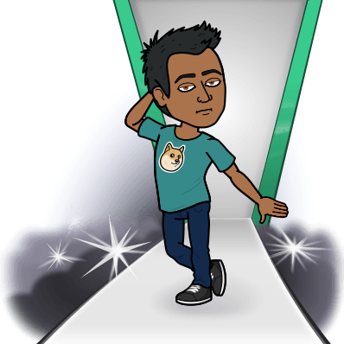
CoolTShirts
CoolTShirts, is an innovative apparel shop. It is running a bunch of marketing campaigns in order to entice users to check out their site and to ultimately go through with a purchase.

Slide 4
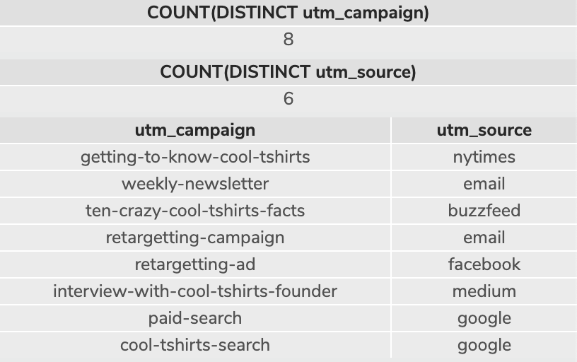
Campaigns & Sources
How many campaigns and sources does CoolTShirts use?
CoolTshirts uses 8 campaigns from 6 sources.
Which source is used for each campaign?
The sources used for each campaign are the NY Times, Email, Buzzfeed, Facebook, Medium and Google.
Difference between utm_source and utm_campaign?
utm_source is where the user came from before being brought to the CoolTShirts site. A utm_campaign is the mode of communication that is broadcasted to users to display how and what CoolTshirts is promoting.
--How many campaigns and sources does CoolTShirts use? Which source is used for each campaign?--
SELECT COUNT(DISTINCT utm_campaign)
FROM page_visits;
SELECT COUNT(DISTINCT utm_source)
FROM page_visits;
SELECT DISTINCT utm_campaign,
utm_source
FROM page_visits;

Slide 5

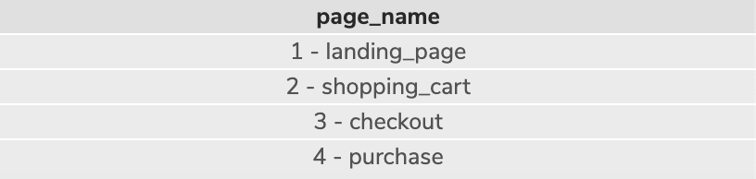
Pages on the CoolTShirts Website
What pages are on the CoolTShirts website?
The pages that are on the CoolTShirts Website are: landing page, shopping cart, checkout, and purchase.
--What pages are on the CoolTShirts website?--
SELECT DISTINCT page_name
FROM page_visits;
page_name
1 - landing_page
2 - shopping_cart
3 - checkout
4 - purchase

Slide 6

User Journey
A user journey is the experience a customer has on any given platform to perform an ultimate goal. In our case study, we examine how a user interacts and navigates the CoolTShirts website in various ways all the way from first landing to checkout.

Slide 7

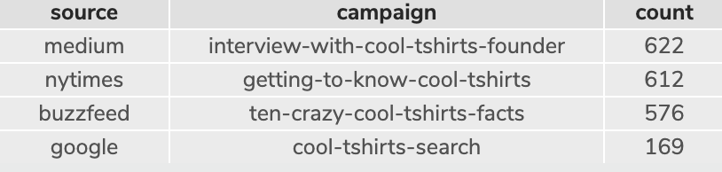
First Touch
How many first touches is each campaign responsible for?
First touch indicates the first time the user was exposed to the site and which landing page. The query pulls up the minimum value and sets it as the first touch time.
Please see chart below and ran query result to the right for the first touch counts.
--How many first touches is each campaign responsible for?--
WITH first_touch AS (
SELECT user_id
,MIN (timestamp) AS 'first_touch_time'
FROM page_visits
GROUP BY user_id),
ft_count AS (
SELECT ft.user_id
,ft.first_touch_time
,pv.utm_source
,pv.utm_campaign
FROM first_touch AS 'ft'
JOIN page_visits AS 'pv'
ON ft.user_id = pv.user_id
AND ft.first_touch_time = pv.timestamp
)
SELECT ft_count.utm_source AS 'source'
,ft_count.utm_campaign AS 'campaign',
COUNT (*) AS 'count'
FROM ft_count
GROUP BY 1,2
ORDER BY 3 DESC;
source | campaign | count
medium | Interview-with-cool-tshirts-founder | 622
nytimes | getting-to-know-cool-tshirts | 612
buzzfeed | ten-crazy-cool-tshirts-facts | 576
google | cool-tshirts-search | 169

Slide 8
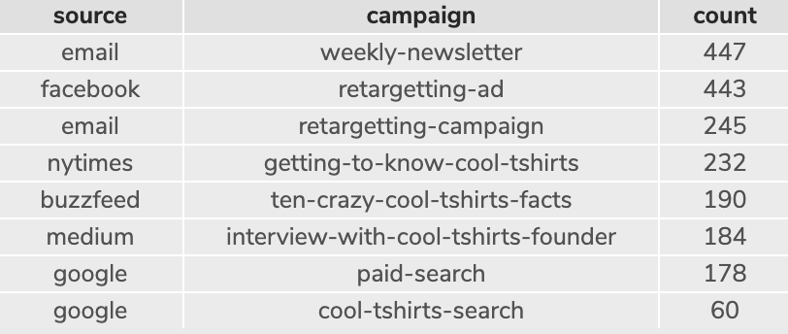
Last Touch
How many last touches is each campaign responsible for?
Last touch indicates is the last/max time the user was spent on the site. The query pulls up the maximum value and sets it as the last touch time.
Please see the chart below or the ran query result to the right for the last touch counts.
--How many last touches is each campaign responsible for?—
WITH last_touch AS (
SELECT user_id,
MAX(timestamp) AS 'last_touch_time'
FROM page_visits
GROUP BY user_id),
lt_count AS (
SELECT lt.user_id,
lt.last_touch_time,
pv.utm_source,
pv.utm_campaign
FROM last_touch AS 'lt'
JOIN page_visits AS 'pv'
ON lt.user_id = pv.user_id
AND lt.last_touch_time = pv.timestamp
)
SELECT lt_count.utm_source AS 'source',
lt_count.utm_campaign AS 'campaign',
COUNT (*) AS 'count'
FROM lt_count
GROUP BY 1,2
ORDER BY 3 DESC;
source | campaign | count
email | weekly-newsletter | 447
facebook | retargeting-ad | 443
email | retargeting-campaign | 245
nytimes | getting-to-know-cool-tshirts | 232
buzzfeed | ten-crazy-cool-tshirts-facts | 190
medium | interview-with-cool-tshirts-founder | 184
google | paid-search | 178
google | cool-tshirts-search | 160

Slide 9
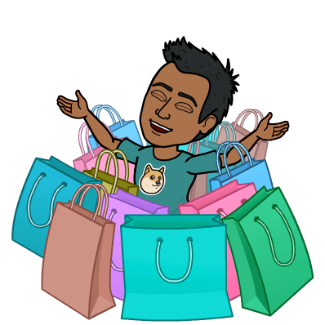
Purchases
How many visitors make a purchase?
361 visitors made purchases
--How many visitors make a purchase?--
SELECT DISTINCT COUNT(*)
FROM page_visits
WHERE page_name = '4 - purchase';
COUNT(*)
361

Slide 10
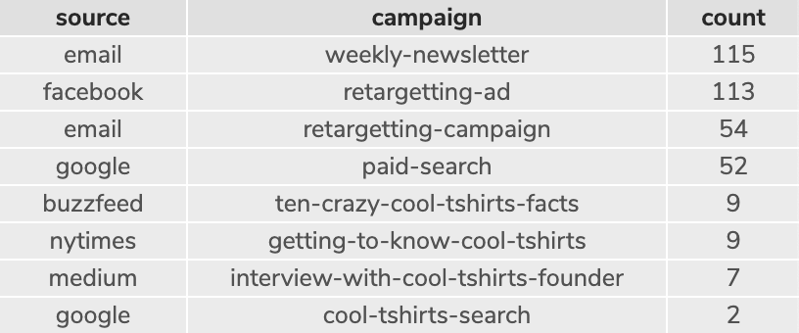

Last Touch Users Who Made Purchases
How many last touches on the purchases page is each campaign responsible for?
Please see chart below or the ran query result to the right.
--How many last touches on the purchase page is each campaign responsible for?--
WITH last_touch AS (
SELECT user_id,
MAX(timestamp) AS 'last_touch_time'
FROM page_visits
WHERE page_name = '4 - purchase'
GROUP BY user_id),
lt_count AS (
SELECT lt.user_id,
lt.last_touch_time,
pv.utm_source,
pv.utm_campaign
FROM last_touch AS 'lt'
JOIN page_visits AS 'pv'
ON lt.user_id = pv.user_id
AND lt.last_touch_time = pv.timestamp
)
SELECT lt_count.utm_source AS 'source',
lt_count.utm_campaign AS 'campaign',
COUNT (*) AS 'count'
FROM lt_count
GROUP BY 1,2
ORDER BY 3 DESC;
source | campaign | count
email | weekly-newsletter | 115
facebook | retargetting-ad | 113
email | retargetting-campaign | 54
google | paid-search | 52
buzzfeed | ten-crazy-cool-tshirts-facts | 9
nytimes | getting-to-know-cool-tshirts | 9
medium | Interview-with-cool-tshirts-founder | 7
google | cool-tshirts-search | 2

Slide 11
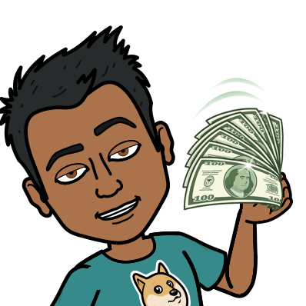
Optimizing the campaign budget
CoolTShirts can reinvest on 5 campaigns. Based on the data we pulled from the SQL queries, we can determine which campaigns will benefit the business.

Slide 12
Optimizing Campaign Budget
Upon looking at the data we pulled from the queries, CoolTShirts wants to find the most cost effective campaigns, and sources that generate the largest return on investments. The campaigns that work best in promoting sales are: weekly newsletters (email), retargeting ad (Facebook), retargeting campaigns (email), and paid search (Google). Other avenues to which we can seek to expanding and refining are sources in the New York Times and in Buzzfeed as those are high volume visited sites.

Slide 13

Thank You!

